Slide 1

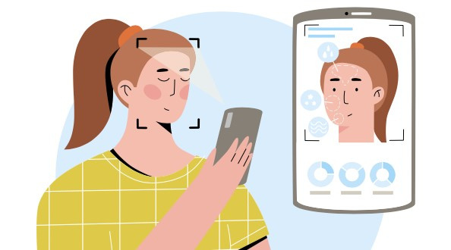
Al-based tool for preliminary diagnosis of Dermatological manifestations
Presentation By:
1. Vidisha Khandale [ Team Leader ]
2. Akshata Gedam
3. Lokesh Mendke
4. Jatin Deshmukh
Guided by : Prof. Hrushikesh Panchabudhe

Slide 2

Introduction
Skin diseases rank 4th in global nonfatal disease burden.
Often indicators of more severe systemic illnesses like HIV and neglected tropical diseases (NTD).
Skin disorders significantly impact patients' well-being, mental health, and social participation.
Difficult to provide adequate dermatological care in under-served regions due to lack of diagnostic tools, connectivity, and physician shortage.
Developing AI-based tools for preliminary diagnosis can greatly enhance healthcare accessibility.

Slide 3
Objectives of the Project
Develop an artificial intelligence-based tool for preliminary diagnosis of various dermatological conditions.
03.
Enhance early detection and intervention for dermatological manifestations, potentially reducing morbidity and improving patient outcomes.
01.
02.
Improve access to dermatological care in underserved regions by providing a cost-effective and efficient diagnostic solution.
04.
Facilitate remote consultation and diagnosis, leveraging connectivity to bridge gaps in healthcare delivery.

Slide 4
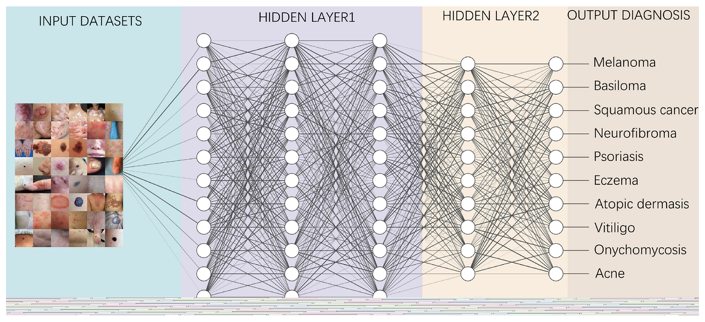
Methodology
´The project will utilize image processing techniques and machine learning algorithms to develop an AI-based tool capable of analyzing dermatological images for preliminary diagnosis. The methodology involves:
Collecting a diverse dataset of dermatological images representing various skin conditions.
Preprocessing and augmenting the image data to enhance model robustness and generalization.
Implementing machine learning algorithms, such as convolutional neural networks (CNNs), to train the model on the dataset.
Fine-tuning the model parameters and optimizing performance using techniques like cross-validation.
Integrating the trained model into a user-friendly software application for easy deployment and utilization by healthcare providers.

Slide 5
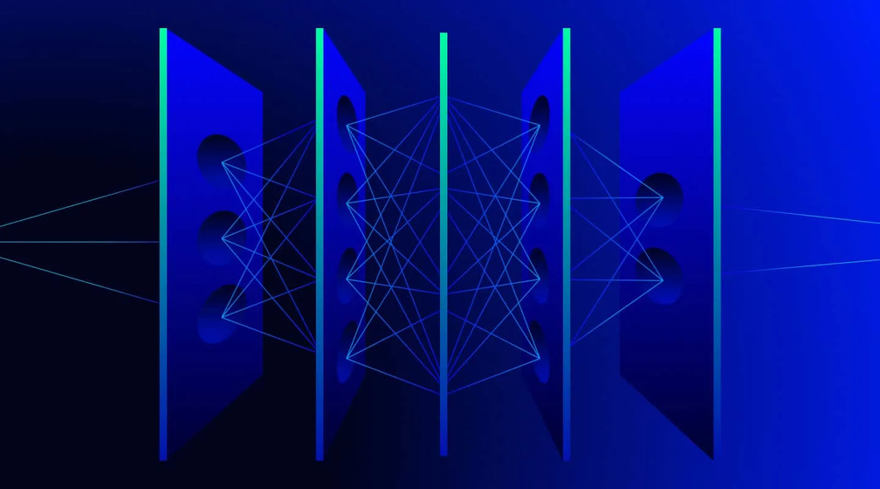
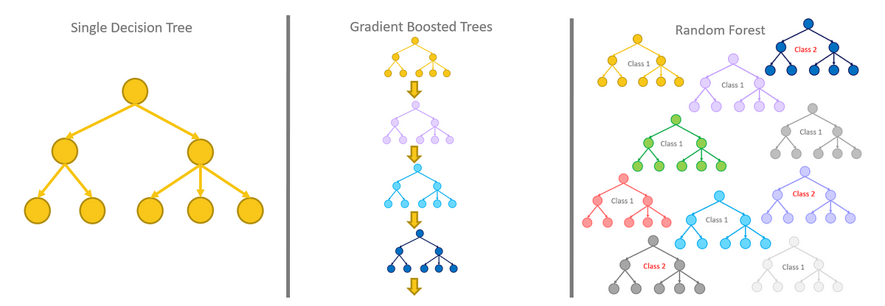
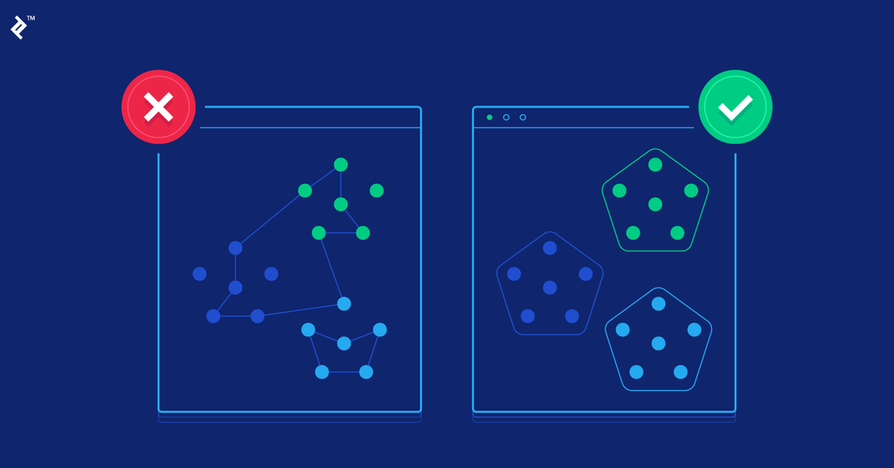
Machine Learning Algorithms
Convolutional Neural Networks (CNNs): CNNs are commonly used for image recognition and classification tasks, making them well-suited for analyzing dermatological images in this project.
Random Forests and Gradient Boosting Machines: These ensemble learning methods can be employed for classification tasks and may complement deep learning approaches.
Clustering Algorithms: Techniques like k-means clustering might be useful for exploratory data analysis or grouping similar dermatological images.
´

Slide 6

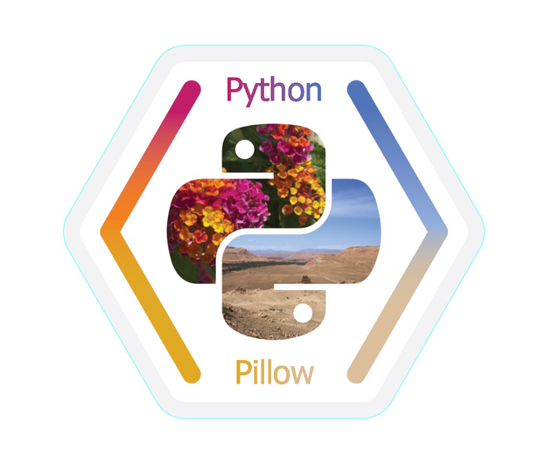
Image Processing Libraries
OpenCV: OpenCV is a widely used library for image processing and computer vision tasks, offering various functions for image manipulation, feature extraction, and object detection.
Pillow: Pillow is a Python Imaging Library (PIL) fork that provides easy-to-use functions for opening, manipulating, and saving many different image file formats.

Slide 7
Expected Outcomes
Development of a software tool capable of accurately diagnosing a wide range of dermatological conditions based on image analysis.
Increased accessibility to dermatological care, particularly in underserved regions with limited resources.
Early detection and intervention for dermatological manifestations, potentially reducing disease progression and improving patient outcomes.
Enhanced efficiency and cost-effectiveness in dermatological diagnosis, contributing to overall healthcare system improvement.

Slide 8
Challenges Anticipated
01.
02.
03.
Availability and quality of dermatological image datasets for training the AI model.
Ensuring the accuracy and reliability of the AI-based diagnostic tool across diverse populations and skin types.
Addressing ethical and privacy concerns related to the use of patient data and AI algorithms in healthcare.
04.
05.
Integrating the software tool into existing healthcare infrastructure and workflows.
Providing adequate training and support for healthcare providers to effectively utilize the AI-based tool in clinical practice.

Slide 9
Research Papers
"Automated Dermatological Diagnosis: Hype or Reality?" by GielisHeerkens et al.
"Artificial Intelligence in Dermatology: A Primer" by SagiShpigelman et al.
"A Deep Learning System for Differential Diagnosis of Dermatological Diseases" by Yuan Cao et al.
"Evaluation of a Deep Learning-Based System for Skin Disease Diagnosis in Comparison with Clinical Human Evaluations" by Andre Esteva et al.
"Dermatologist-level classification of skin cancer with deep neural networks" by Andre Esteva et al.

Slide 10
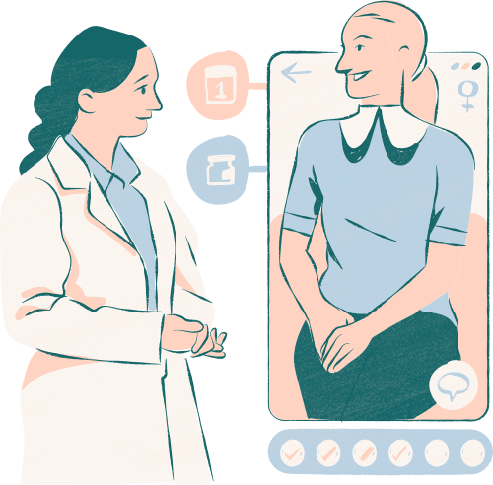
Conclusion
AI-based tools offer promising solutions for preliminary dermatological diagnosis.
Improved accessibility and efficiency in identifying skin diseases.
Addressing challenges of healthcare disparities and physician shortages.
Ethical considerations and integration into existing healthcare systems remain key priorities.
Collaboration between stakeholders crucial for successful implementation and adoption.

Slide 11
Thank You !

